Slide 1


Customer Booking Analysis & Prediction
RAMESH BONALA

Slide 2

A Machine Learning Approach for Predicting Booking Completion

Slide 3
Project Overview
Objective:
Analyzed customer booking data to predict the likelihood of booking completion.
Used machine learning models to identify important features influencing booking completion.
Dataset:
Source: Customer booking data (CSV format)
Key variables: Flight details, booking status, customer information, etc.

Slide 4
Data Preprocessing
Data Cleaning: Handled missing values, dropped irrelevant columns.
Feature Engineering:
Created features like "is_weekend_flight" and "is_long_trip."
Applied one-hot encoding to categorical variables.
Exploratory Data Analysis (EDA):
Visualized distributions of important features (e.g., booking completion status).

Slide 5

Feature Engineering & Encoding
Feature Creation:
Weekend Flight Flag: Identified if the flight is on the weekend.
Long Trip Flag: Flagged trips longer than 7 days.
One-Hot Encoding:
Converted categorical variables like sales_channel, trip_type, and flight_day into binary features.

Slide 6
Data Splitting & Model Preparation
Training/Test Split:
Split the data into 70% training and 30% testing.
Target Variable:
Booking Complete: Predicting whether the booking is completed (binary classification).

Slide 7
Machine Learning Models
Models Used:
Logistic Regression
Decision Tree Classifier
Random Forest Classifier
Gradient Boosting Classifier
Evaluation Metrics:
Accuracy
ROC-AUC score

Slide 8

Model Training & Evaluation
Performance Results:
Accuracy & ROC-AUC: Model | Accuracy | ROC-AUC | Precision (Class 0) | Precision (Class 1) | Recall (Class 0) | Recall (Class 1) | F1-Score (Class 0) | F1-Score (Class 1)
Logistic Regression | 0.8505 | 0.5000 | 0.85 | 0.00 | 1.00 | 0.00 | 0.92 | 0.00
Decision Tree | 0.7567 | 0.5502 | 0.87 | 0.22 | 0.84 | 0.26 | 0.86 | 0.24
Random Forest | 0.8462 | 0.5210 | 0.86 | 0.40 | 0.98 | 0.06 | 0.92 | 0.10
Gradient Boosting | 0.8501 | 0.5005 | 0.85 | 0.31 | 1.00 | 0.00 | 0.92 | 0.00
Classification Report: Precision, recall, and F1-score for each model.
Key Findings:
Random Forest showed the highest performance.

Slide 9
Cross-Validation
Model Validation:
Applied 5-fold cross-validation for all models.
Cross-Validation ROC-AUC scores: Provided mean and standard deviation for each model.
Result: Cross-validation confirmed Random Forest's robustness.

Slide 10
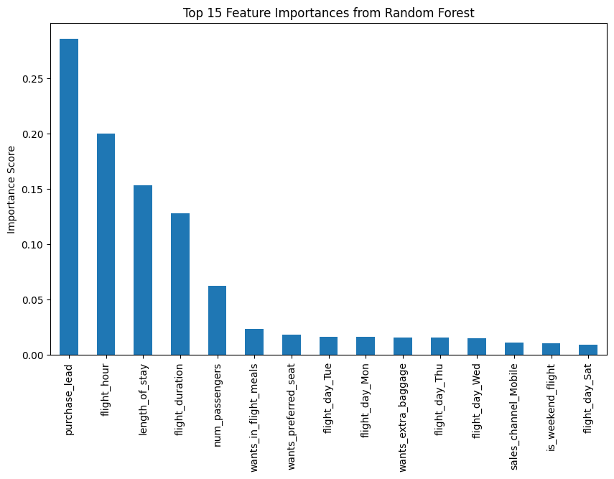
Feature Importance (Random Forest)
Key Findings:

Slide 11

Confusion Matrix
Confusion Matrix for Best Model (Random Forest):
True Positives: Correctly predicted completed bookings.
True Negatives: Correctly predicted incomplete bookings.
False Positives & False Negatives: Errors made by the model.
Interpretation: Provide insights into the model's performance in different scenarios.

Slide 12

Performance Summary Table
Comparison of All Models:
Model | Accuracy | ROC-AUC | Cross-Validation ROC-AUC
Logistic Regression | 0.8505 | 0.5000 | 0.6358
Decision Tree | 0.7567 | 0.5502 | 0.4510
Random Forest | 0.8462 | 0.5210 | 0.4406
Gradient Boosting | 0.8501 | 0.5005 | 0.4581
Result: Random Forest performs the best in all metrics.

Slide 13

Conclusion
Key Takeaways:
Random Forest model outperforms other models in predicting booking completion.
Feature engineering plays a significant role in model performance.
Further improvements could include hyperparameter tuning and incorporating more features.
Next Steps:
Model deployment and testing in real-world scenarios.
Continuous monitoring and model updates as new data arrives.

Slide 14

Thank You
Questions?

